Slide 1
Simulation assignment the UITHOFLIJN
Orestis melkonian
Chris aronis

Slide 2
Problem description
A new tram-line connecting Utrecht with the Utrecht University
Nine stops from Central station to P+R De Uithof
The line operates from 06:00 to 21:30
Two different timetables one for each end station
All trams have a fixed capacity of 420 passengers

Slide 3
Problem description
Questions to be answered:
Feasible frequencies of the tram
Maximum amount of passengers that line can handle
Possible measures to improve the operational performance
SIMULATION

Slide 4
Problem description
Simulation model:
Events
Initialization
State
Event handlers
Performance Measures

Slide 5
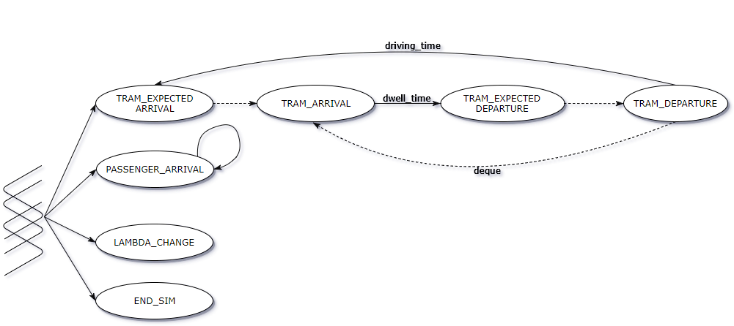
Problem description
Event graph

Slide 6

Problem description
Performance Measures
Punctuality:
$departure delay=t_{actual}− t_{timetable}$
Passenger Waiting Times:
$waiting time=t_{boarding}− t_{arrival}$
Stop Congestion:

Slide 7
Input analysis

Slide 8
Output analysis

